Slide 1
Image Segmentation Dataset
Group 2
Sarah Fontenot, Rawan Alsagheer, Justin Nguyen, Carroll Vance

Slide 2
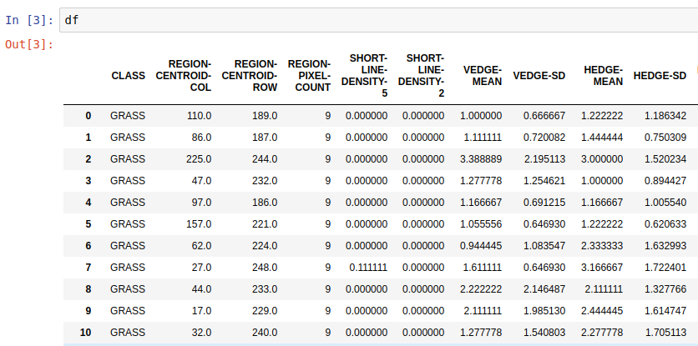

The Dataset
Tabular features...
7 classes
Grass, path, window, cement, foliage, sky and brickface
19 attributes derived from segments of images
18 continuous
1 integer (constant)
All numerical
2253 instances
...derived from...
...image segments

Slide 3
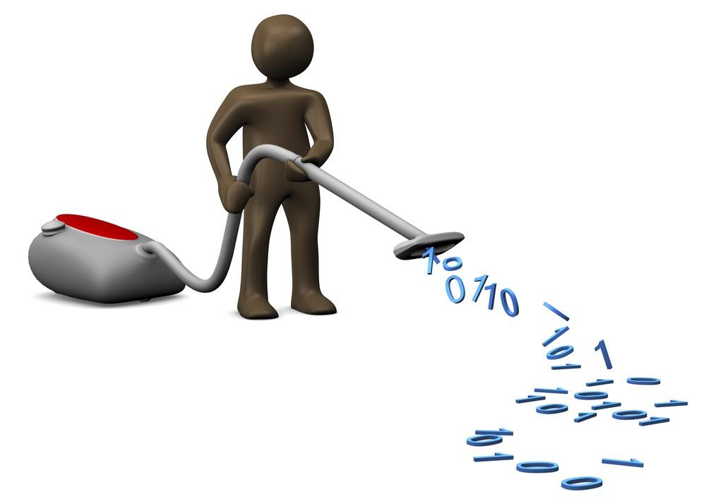
Data Cleaning
47 duplicates rows removed
1 constant attribute removed
Pixel count; all instances had 9 pixels

Slide 4
Neural Networks
Sarah Fontenot

Slide 5
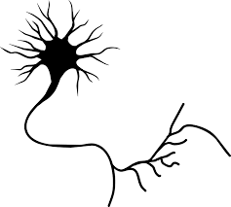
Neural Networks
Classification models which resemble nerve cells both in form and in growth behavior
Three layer types:
Input
Output
Hidden

Slide 6

Software and Packages
RStudio
Two packages:
readr
Used for loading the .csv file into a data frame
neuralnet
Used to generate the neural networks and test them against validation set(s)

Slide 7
Preprocessing
Image Type | Number
GRASS | 1
PATH | 2
WINDOW | 3
SKY | 4
FOLIAGE | 5
CEMENT | 6
BRICKFACE | 7
Z-score standardization
Min-max normalization was tested and found inferior
Class variable transformed from a series of image types to a series of numbers (see right)
Done to simplify validation testing
Not necessary

Slide 8
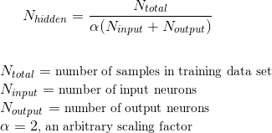
Parameters
formula: class ∼ .
hidden: c(38)
One hidden layer with 38 nodes
Node count from formula
err.fct: “ce”
Cross-entropy error calculation
linear.output: FALSE
act.fct (used in default state "logistic") applied to output neurons
threshold: .03
Stopping criteria

Slide 9
Model Creation
Neural network generated using aforementioned parameters
10-fold cross validation: models created using 9 parts of each fold, validation accuracy computed using remaining part
Each instance prediction determined by using max() function on probability matrix (see below)
All validation accuracies stored in table, alongside average validation accuracy
Image Type | 1 | 2 | 3 | 4 | 5 | 6 | 7
Probability | Close to 0 | Close to 0 | Close to 0 | Close to 1 | Close to 0 | Close to 0 | Close to 0

Slide 10
Validation Accuracies
Run | Validation Accuracy
1 | 0.9646
2 | 0.9689
3 | 0.9689
4 | 0.9733
5 | 0.9602
6 | 0.9867
7 | 0.9689
8 | 0.9822
9 | 0.9689
10 | 0.9912
Average | 0.9734

Slide 11
Validation Accuracies
Run | Validation Accuracy
1 | 0.9646
2 | 0.9689
3 | 0.9689
4 | 0.9733
5 | 0.9602
6 | 0.9867
7 | 0.9689
8 | 0.9822
9 | 0.9689
10 | 0.9912
Average | 0.9734
Average accuracy:
97.34%

Slide 12
Validation Accuracies
Run | Validation Accuracy
1 | 0.9646
2 | 0.9689
3 | 0.9689
4 | 0.9733
5 | 0.9602
6 | 0.9867
7 | 0.9689
8 | 0.9822
9 | 0.9689
10 | 0.9912
Average | 0.9734
Average accuracy:
97.34%
Highest accuracy:
99.12%

Slide 13
Validation Accuracies
Run | Validation Accuracy
1 | 0.9646
2 | 0.9689
3 | 0.9689
4 | 0.9733
5 | 0.9602
6 | 0.9867
7 | 0.9689
8 | 0.9822
9 | 0.9689
10 | 0.9912
Average | 0.9734
Average accuracy:
97.34%
Highest accuracy:
99.12%
Lowest accuracy:
96.02%

Slide 14
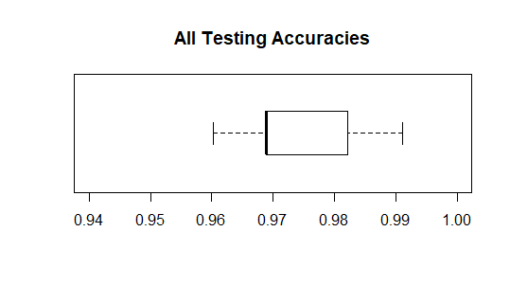
Validation Accuracies Boxplot
All testing accuracies fairly close to one another
Shows that shuffling and fold generation are good; each subset is representative of the data set as a whole

Slide 15
Neural Network Plot from RStudio
Prepare yourselves...

Slide 16
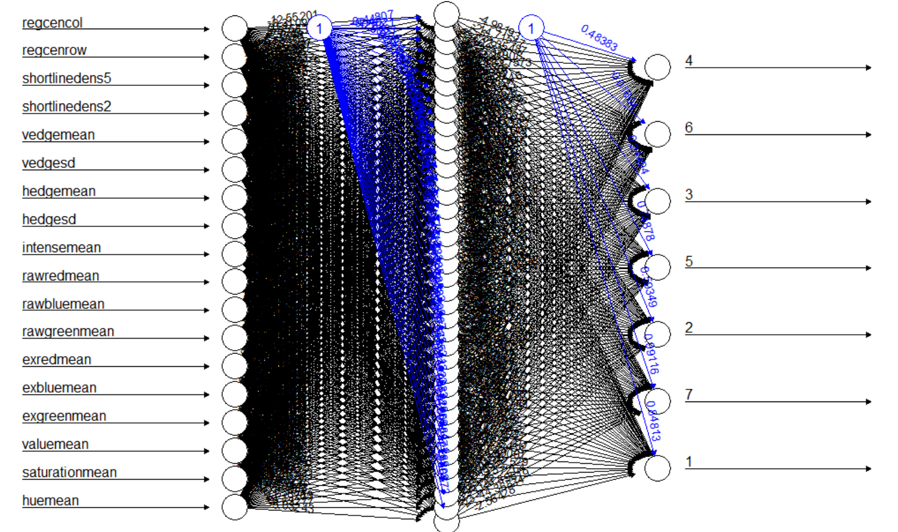

Slide 17
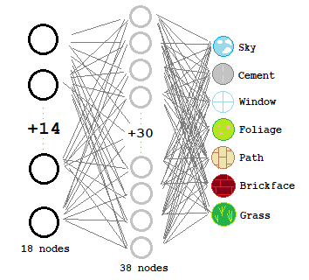
Simplified
Version

Slide 18
Support Vector Machine
Rawan Alsagheer

Slide 19
Support Vector Machine
C_SVM Classification Method
MultiClass SVM (binary SVM is another approach)
Z-score standardization
10-folds cross validation.
Parameters:
Formula: CLASS~.
kernel = “polynomial”, “sigmoid”, “linear”, “radial”
gamma = A number between 0,1
C ( size of margin), 1 is the default
R command: svm(CLASS~., data = traindata, kernel = “”, cross = 10)

Slide 20
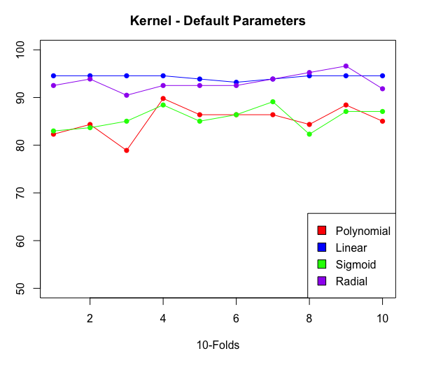
SVM
Y-axis = Accuracy %
mean(Radial) = 93.2
mean(Linear) = 94.3
mean(Sigmoid) = 85.7
mean(Polynomial) = 85.2
Based on default Gamma and
C = 1, Linear kernel has the most accuracy.
The smaller γ is, the more the hyperplane is going to look like a straight line.If γ is too great, the hyperplane will be more curvy

Slide 21
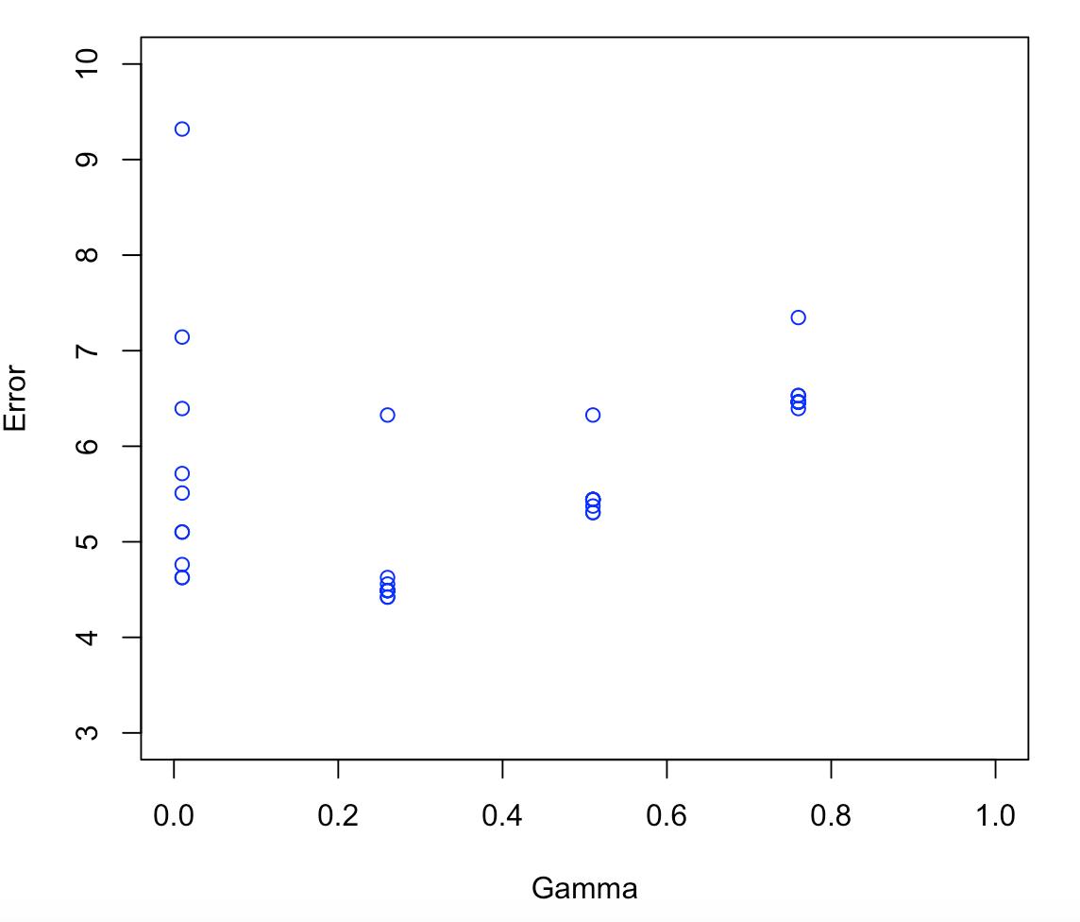
SVM- Best Parameters
Tune.svm() determines the best parameters to gain better performance.
Test gamma = (0,1) and cost = (1-50)
Best performance: 0.04 in Error
Best parameters:
gamma = 0.26
Cost = 31

Slide 22
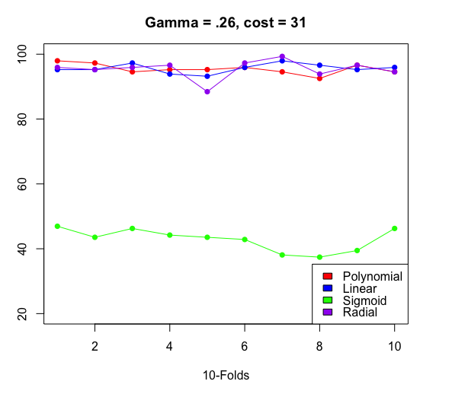
SVM
Using selected parameters
Accuracy %:
mean(Radial) = 95.4
mean(Linear) = 95.6
mean(Sigmoid) = 42.9
mean(Polynomial) = 95.4

Slide 23
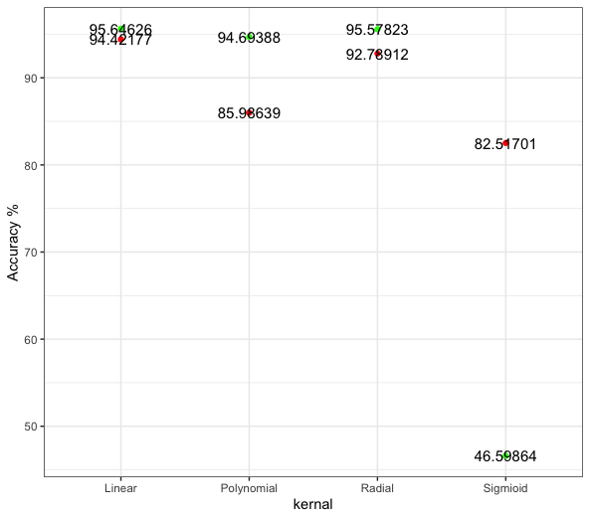
Default Parameters VS Selected parameters
Highest 95.6%

Slide 24
Random Forest
Justin Nguyen

Slide 25
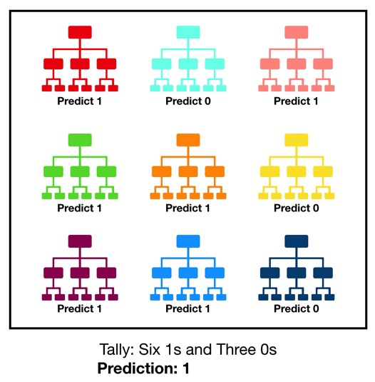
Random Forest
Ensemble method that aggregates many decision trees
Hyperparameters
Number of trees
Random seed
Bootstrap (yes or no)
Model Validation
10-fold cross validation
10 folds, averaged

Slide 26

Random Forest- Software and Packages
Python 3.7
Pandas
Scikit-learn
Matplotlib

Slide 27
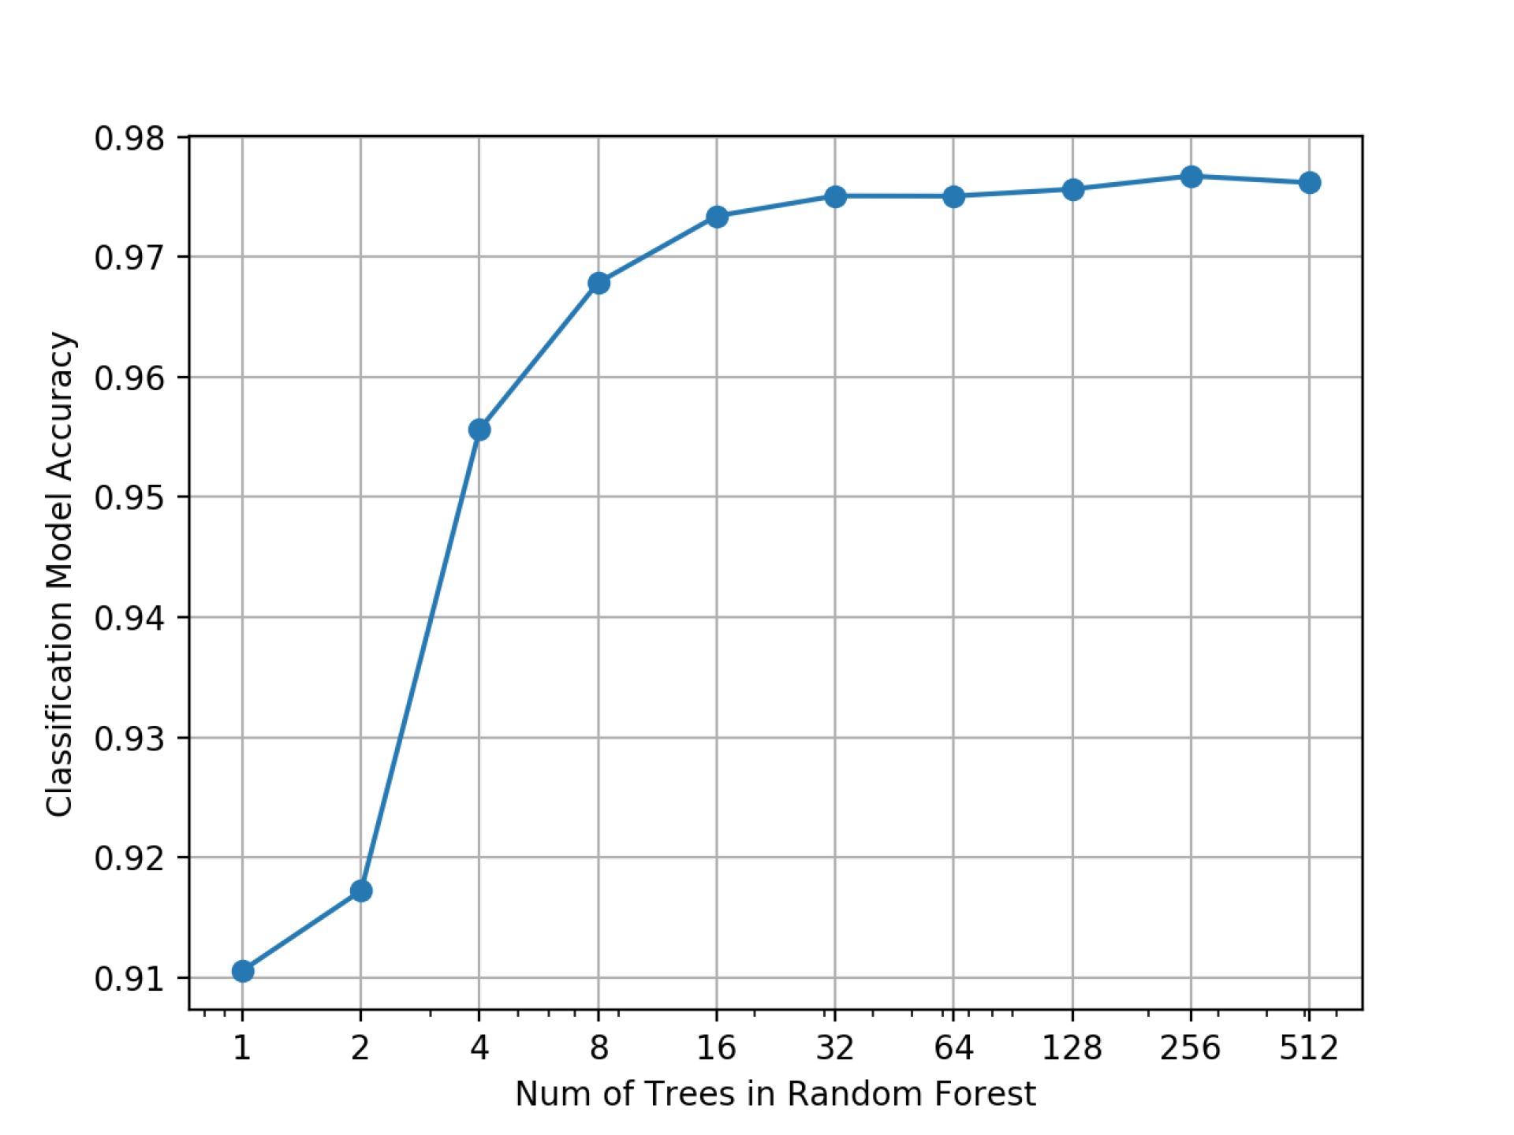
Random Forest- Results
Increasing the number of trees increases the accuracy of the model to a certain extent
256 is the best value for the hyperparameter “n_estimators” (number of trees)
Highest model accuracy produced is 97.76%

Slide 28
K-Nearest Neighbors
Carroll Vance

Slide 29
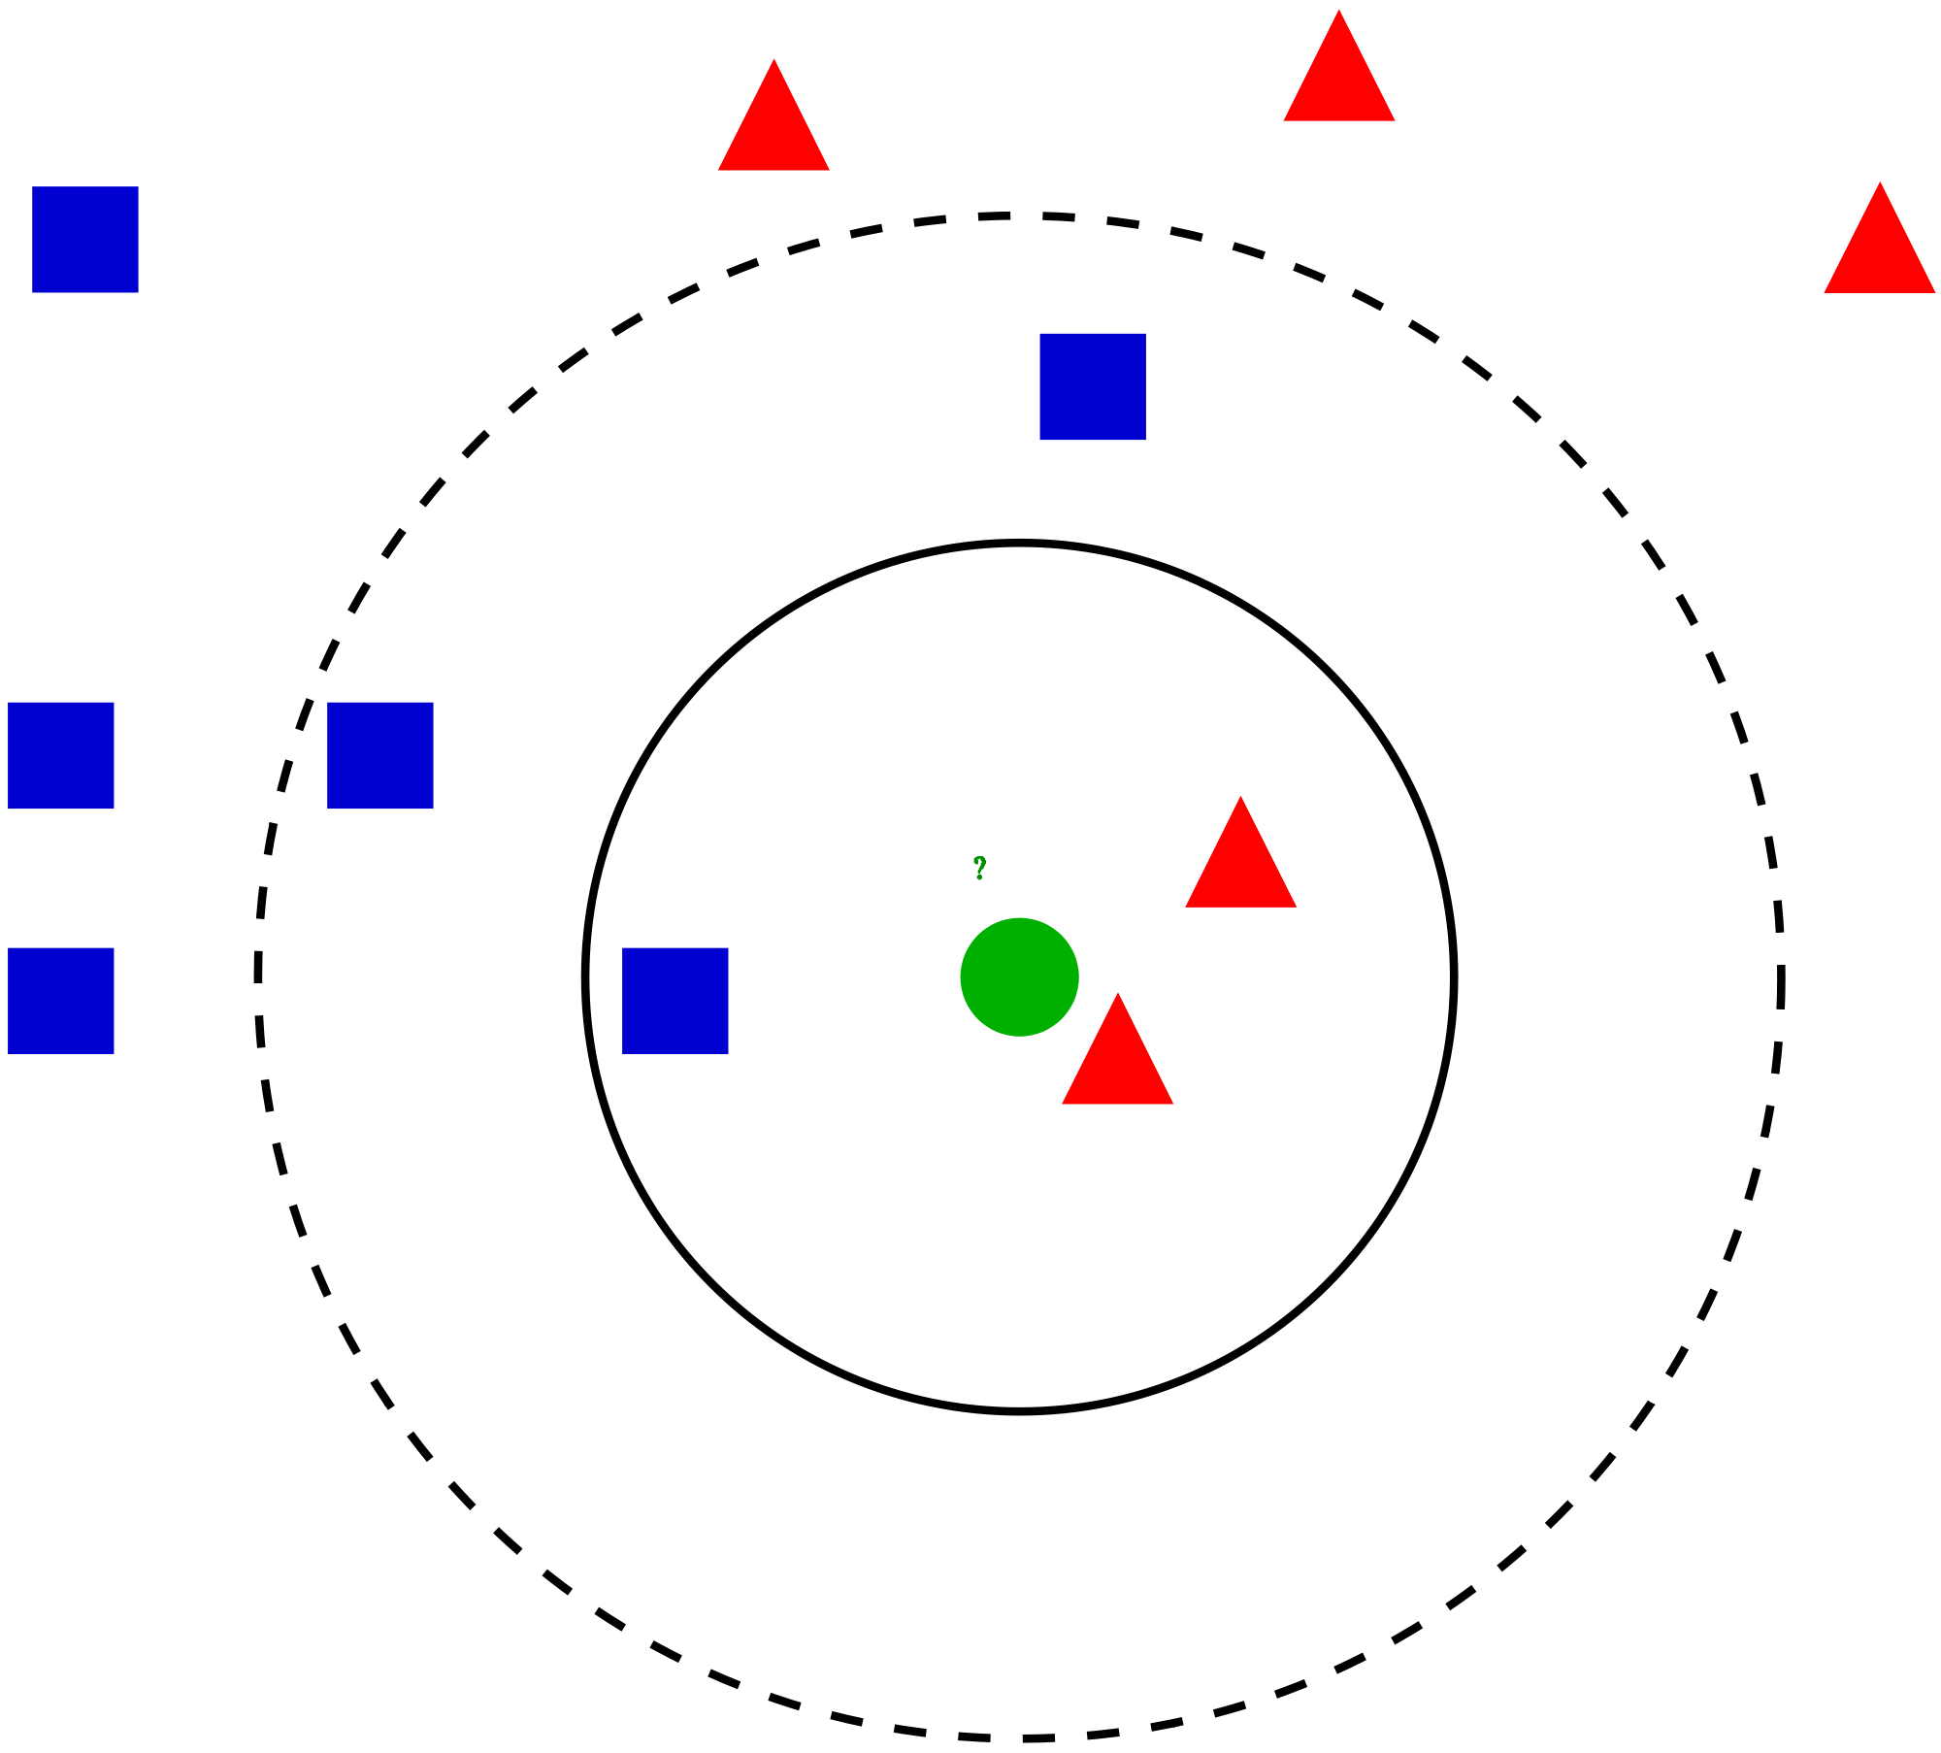
K-Nearest Neighbors
Classify input based on nearest (most similar) k-neighbors
Hyperparameters
Distance function (L1, L2, Chebyshev...)
k in {1, 2, …, 10}
Voting in {distance, uniform}
Preprocessing
z-score (mean=0, std=1)

Slide 30
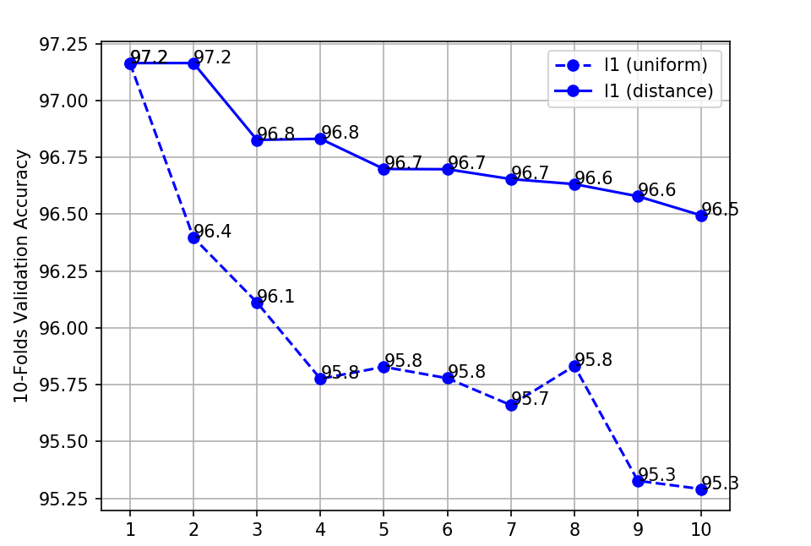
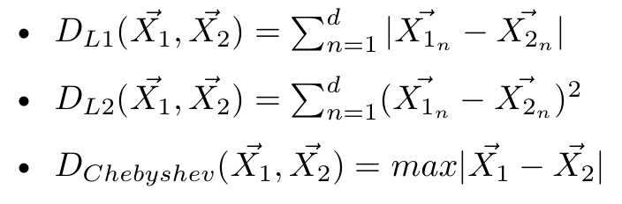
KNN: L1 (aka Manhattan) Distance Function
Good!

Slide 31
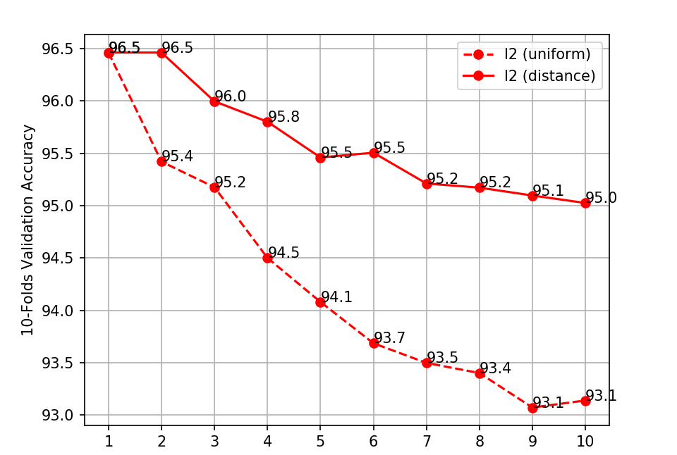
KNN: L2 (aka Euclidean) Distance Function
Not as good…
Note
Since sqrt is monotonic, we can omit it when calculating L2 distance

Slide 32
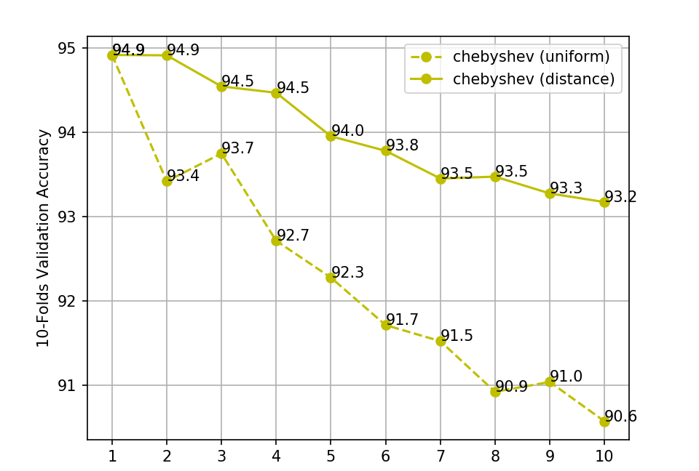
KNN: Chebyshev Distance Function
:’(

Slide 33

KNN: Analysis
Increasing k doesn’t increase performance for uniform or distance voting
Top result hyperparameters:
Voting:
Uniform - k = 1
Distance - k in {1, 2}
Distance Function: L1

Slide 34
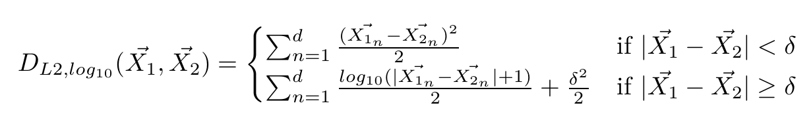
KNN: Lessons from Robust Regression?
Reduce distance between very similar attribute values
Punish large differences in individual attributes less

Slide 35
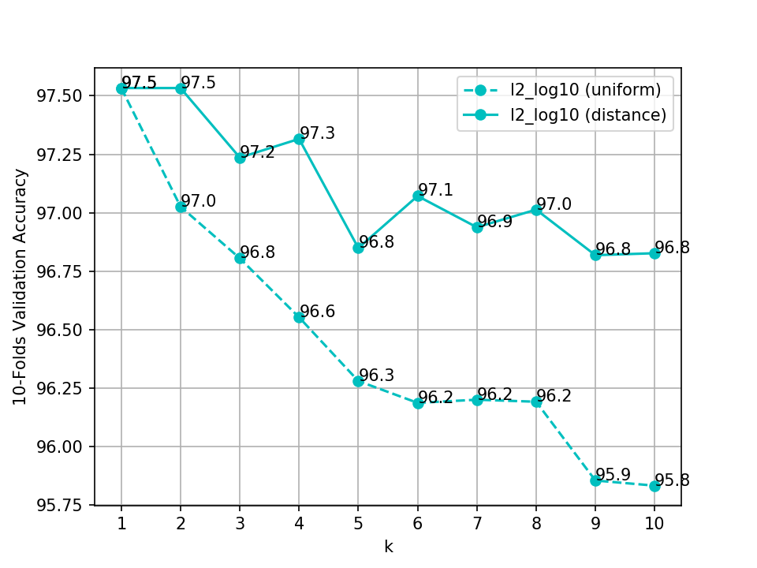
KNN: Piecewise Distance Function
Subtract 0.3% error from L1
12% of the incorrectly classified records from L1 are now correct.

Slide 36
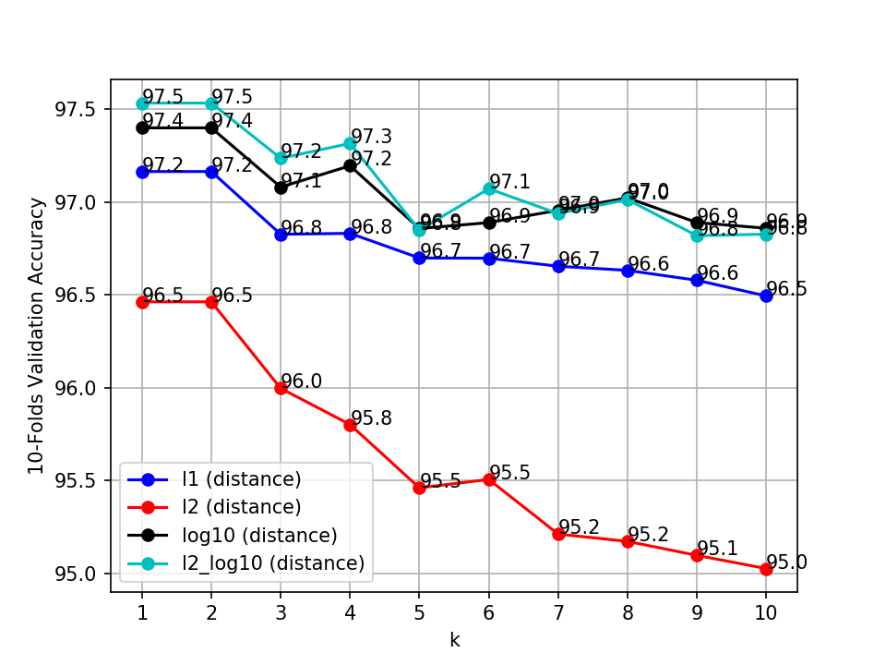
KNN: Results
Distance Function Ranking
L2_log10
log10
L1
L2
Chebyshev (not displayed)

Slide 37
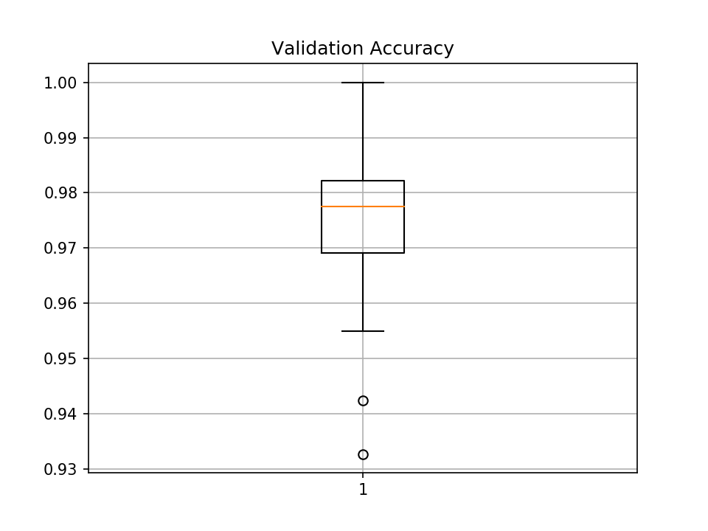
KNN: Best Results
L1 Distance
k=1
Mean Accuracy: ~97.5%
Note: 10-folds with 10 different seeds, averaged

Slide 38
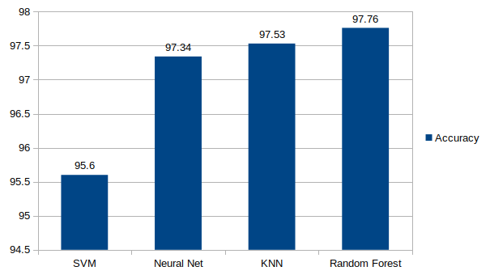
Tuned Model Comparison
Random Forest did the best and needed the least hyperparameter tuning.
KNN: Good, but needed quite a bit of tuning relative to Random Forest.
Neural Net: Similar accuracy to Random Forest and KNN; needed more tuning than Random Forest, less than KNN. Could be improved with stratification.
SVM: Nonlinear kernels didn’t perform well, putting SVM at a disadvantage on this dataset. However, linear SVM still performed respectably.

